Slide 1
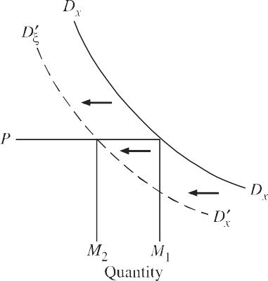
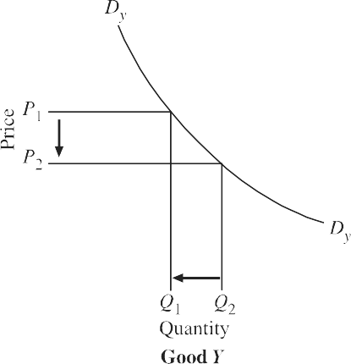
2. CROSS ELASTICITY OF DEMAND
Degree of responsiveness of demand for one good in response to the change in price of another good represents the cross elasticity of demand of one good for the other.
Coefficient of cross elasticity= Percentage change in the quantity demanded of X Percentage change in the price of good Y

Slide 2
Substitute and Complementary Goods
When two goods are substitutes of each other, then as a result of the rise in price of one good, the quantity demanded of the other good increases. Therefore, the cross elasticity of demand between the two substitute goods is positive, that is, in response to the rise in price of one good, the demand for the other good rises. Substitute goods are also known as competing goods.
On the other hand, when the two goods are complementary with each other, the rise in price of one good brings about the decrease in demand for the other. Therefore, the cross elasticity of demand between the two complementary goods is negative. Therefore according to the classification based on the concept of cross elasticity of demand, goods X and Y are substitutes or complements according as the cross elasticity of demand is positive or negative.
Note: The goods between which cross elasticity of demand is positive are known as substitute goods and the goods between which cross elasticity of demand is negative are complementary goods.

Slide 3
Importance of Cross Elasticity of Demand for Business Decision Making
The concept of cross elasticity of demand is of great importance
First, in managerial decision making for formulating proper price strategy. For example, Suzuki Ltd. produces Suzuki Vans, Suzuki Alto and Suzuki Swift. These products are good substitutes of each other and therefore cross elasticity of demand between them is very high.
Second, the concept of cross elasticity of demand is frequently used in measuring interrelationship between industries. (i.e., automobiles).Interrelationship of firms and industries between which cross price-elasticity of demand is positive and high, any one cannot raise the price of its product without losing sales to other firms.
Third concept of cross elasticity of demand is extremely used in deciding cases relating to Anti trust laws and monopolistic practices used by firms. Firms producing close substitutes with high cross elasticity of demand try to merge with each other to form a cartel to enjoy monopolistic profits

Slide 4
Numerical
If the price of coffee rises from Rs. 4.50 per hundred grams to Rs. 5 per hundred grams and as a result the consumer’s demand for tea increases from 60 hundred grams to 70 hundred grams, then the cross elasticity of demand of tea for coffee.

Slide 5
INCOME ELASTICITY OF DEMAND
Income elasticity of demand shows the degree of responsiveness of quantity demanded of a good to a small change in the income of consumers.
Income elasticity= Percentage change in purchases of a good Percentage change income
Zero income elasticity of demand for a good implies that quantity demanded of the good is quite unresponsive to changes in income.
Goods having negative income elasticity are known as inferior goods. Goods with positive income elasticity are called normal goods
A good having income elasticity more than one and which therefore bulks larger in consumer’s budget as he becomes richer is called a luxury. A good with an income elasticity less than one and which claims declining proportion of consumer’s income as he becomes richer is called a necessity

Slide 6
Importance of Income Elasticity for Business Firms
First, the firms producing products which have a high income elasticity have great potential for growth in an expending economy. Firms which are producing products having high income elasticity are more interested in forecasting the level of aggregate economic activity (i.e., level of national income).
Second, on the other hand, the demand for products with low income elasticity will not be greatly affected by the fluctuations in aggregate economic activity. They are to a good extent boom and recession-proof.
The knowledge of income elasticity of demand also plays a significant role in designing marketing strategies of the firms. The firms producing product with high income elasticity of demand will be located in those areas or set up their sales outlets in those cities or regions where incomes are increasing rapidly.
The concept of income elasticity of demand shows clearly why farmers income do not rise equal to that of urban people engaged in manufacturing industries

Slide 7
RELATIONSHIP BETWEEN PRICE ELASTICITY, INCOME ELASTICITY AND SUBSTITUTION ELASTICITY
Price effect, that is, the effect on the quantity demanded of a good due to a change in price, depends upon income effect on the one hand and substitution effect on the other
Price elasticity, in a way, is a compromise between income elasticity and substitution elasticity of demand. The relationship between these three elasticities can be expressed in the form of Slutsky equation.
e_{p} = KX.e_{i} + (1– KX)e_{s}
e_{p} stands for price elasticity of demand.
e_{i} stands for income elasticity of demand.
e_{s} stands for substitution elasticity of demand.
K_{t} stands for the proportion of consumer’s income spent on good X.

Slide 8
Numerical
A consumer is spending 1/5th of his income on any good X and the income elasticity of demand for the good X is 2 and elasticity of substitution between good X and all other good is 3. What will be the price elasticity of demand in this case ?
e_{p} = KX.e_{i} + (1– KX)e_{s}

